Slide 1
Tackling the non-take-up of social security benefits in Italy: the project "INPS per Tutti" and the INPS Portal for Families
INPS Central Directorate for International Relations

Slide 2



Access to rights and social security in Italy
Constitution of the Italian Republc, Art. 38
Welfare State role
In Italy, public welfare intervention is a constitutionally grounded choice aimed at protecting individuals against life-cycle risks
The welfare state plays a key role in preventing social exclusion and ensuring adequate living standards
Equal access
Redistributive impact
Public intervention also extends to the market to ensure equal access to essential benefits and services
The provision of benefits effectively reduces economic, territorial and gender disparities across society

Slide 3
INPS digitalised services: facts and figures
~60 M citizens
Users base
27 M insured persons
15.7 M pensioners
771 M
digitalised services delivered in 2024
30 M
service accesses in the first six months of 2025 (INPS app)
6 M
regular users of the INPS app
Source: INPS XXIV Annual Report, July 2025

Slide 4
Generative welfare: from principles…… to action
Identifying needs
Supporting access
in situations of greater vulnerability too
Intercepting emerging needs
Reaching the most fragile groups
Guiding people towards benefits
Accompanying individuals in accessing services
Facilitating the use of available benefits
Integrating services
Activating networks
Overcoming system fragmentation
Connecting services and institutions
Creating simple and unified pathways
Territorial + digital integration
Strengthening local networks
Leveraging complementary digital platforms

Slide 5
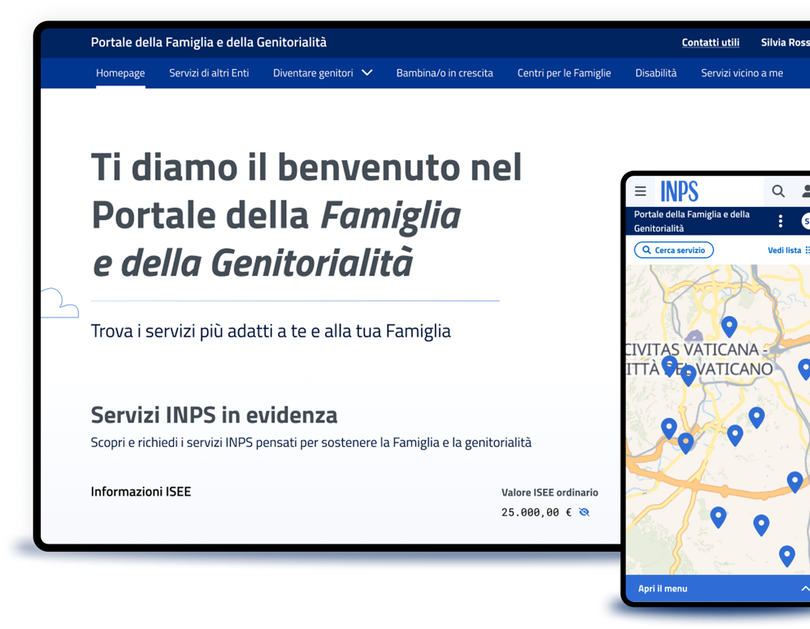

Two examples of generative welfare actions
Evolution of the project "INPS per tutti”
Family and Parenting Portal
Reaching the most vulnerable groups and supporting access to benefits by identifying needs in situations of severe social and economic hardship, through “welcome hubs” managed by project partners.
Supporting people across the entire family journey through a web portal that enhances existing resources and enables new opportunities within a generative welfare framework.

Slide 6
6
Thank you!
Lara Chirico
Team Leader at Central Directorate for International Relations
lara.chirico@inps.it

